Slide 1

Pitch Deck
Joseph Martinez

Slide 2

ABOUT US
About
Cosmic Delineation is a financial analysis site built by investment advisor representatives for investment advisor representatives to build out custom tools for portfolio and market analysis.

Slide 3





PROBLEM
Problem
Software targets traders
Current analytics software is targeted towards traders and chartered analysts and is limited in relevant tools for investment advisors.
Outdated tools dominate
Advisors are left utilizing Excel to run the analysis needed in a way accessible to associates, partners, and clients.
High Opportunity Cost
Time is lost keeping data up-to-date for both current portfolio accuracy and current market analysis.

Slide 4

SOLUTION
Tools Tailored to Advisor Needs
Our product makes understanding your portfolio’s efficiency easier, and no other product on the market offers the same niche focus.
TARGET AUDIENCE
Registered Investment Advisors
Saleable Sophistication
Some tools will be built entirely for any advisor to use easily. Others will require advisors to know basic programming skills for more sophisticated analysis.

Slide 5

MARKET WIDTH
Flexible
Research
Design
Opportunity to build
Fully customized tools, or take
Advantage of existing tools
Explore what is going on in the
Market today, yesterday, Tomorrow!
Test out portfolios or
Compare your allocation to
Your Benchmarks

Slide 6

SEMESTER STRATEGY
FEB 2026
MAR 2026
May 2026
Source Quote Vendors and Databases
Roll out First Test Runs of Correlation Analyis Applications and Tools
Launch Website with Applications Ready to be Utilized by IARs

Slide 7
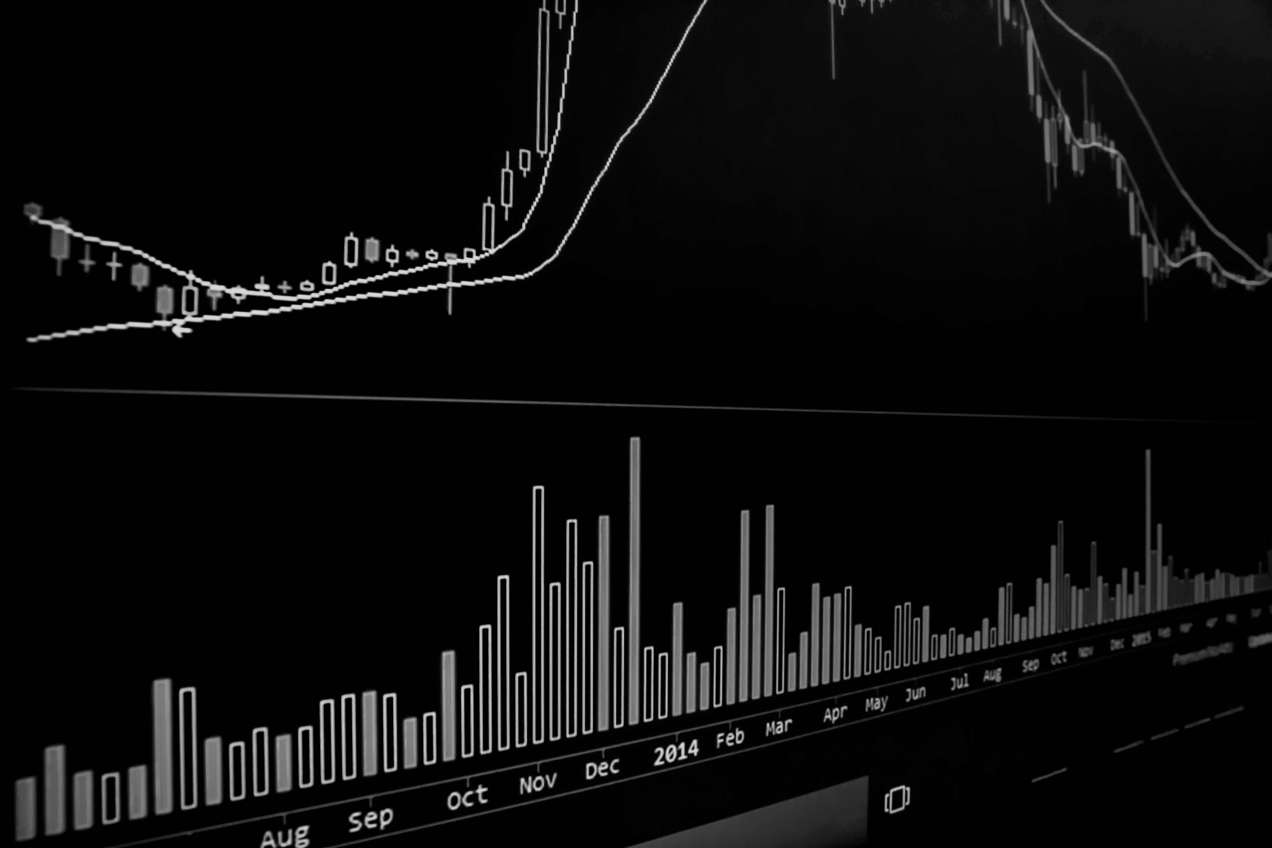
ONE-SEMESTER ACTION PLAN
Source Quote Vendors
Run First Test
Fix Bugs
Feb 2026
March 2026
April 2026
2026
MAY
JAN
FEB
MAR
APR
Receive Feedback
Website Launch May, 2026
April 2026

Slide 8

Ambitious Future
If time allows, more advanced tools will be added to the website to meet the needs of investment advisory representatives and partners within network.
This Photo by Unknown Author is licensed under CC BY

Slide 9



MEET THE TEAM
A detail-oriented financial services professional with Series 65, 7, and 63 licenses and a BA from the University of Texas at Austin. Advanced Excel modeling skills and client-facing experience at both broker/dealers and registered investment advisors. Currently pursuing an MS in Social Data Analytics, enhancing analytical acumen and data reporting capabilities. Eager to contribute to a high-performing, collaborative investment advisory team focused on exceptional client outcomes.
Joseph Martinez
Founder
Cosmic Delineation Pitch Deck

Slide 10

Thank You
Joseph Martinez
210-837-0859
martinez.joseph@me.com
Martinezjoseph0517.github.io

